Slide 1
HDD OVERVIEW
General construction
A hard disk uses round, flat disks called platters, coated on both sides with a special media material designed to store information in the form of magnetic patterns.
The platters are mounted by cutting a hole in the center and stacking them onto a spindle. The platters rotate at high speed, driven by a special spindle motor connected to the spindle.
Special electromagnetic read/write devices called heads are mounted onto sliders and used to either record information onto the disk or read information from it. The sliders are mounted onto arms, all of which are mechanically connected into a single assembly and positioned over the surface of the disk by a device called an actuator.
A logic board controls the activity of the other components and communicates with the rest of the PC.

Slide 2
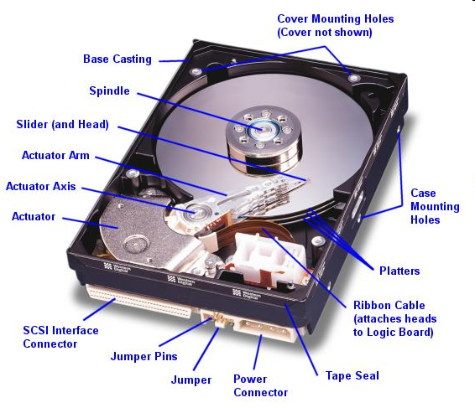
HDD OVERVIEW
General construction

Slide 3
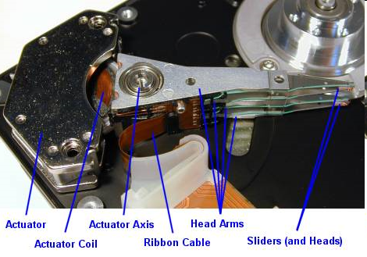
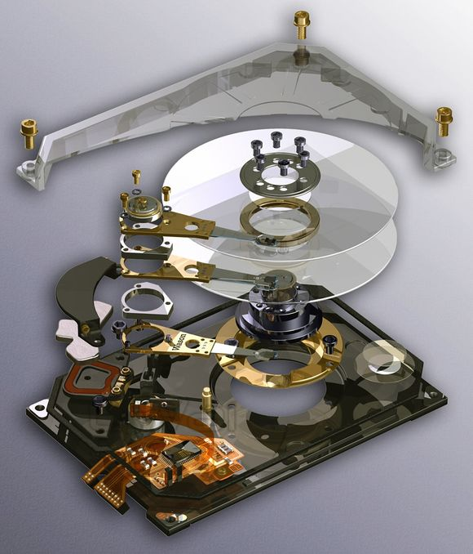
HDD OVERVIEW
General construction

Slide 4
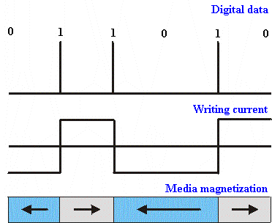
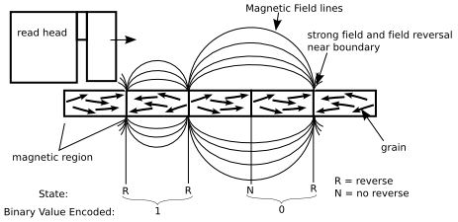
HDD OVERVIEW
Data storage principle
HDDs record data by magnetizing ferromagnetic material directionally, to represent either a 0 or a 1 binary digit. They read the data back by detecting the magnetization of the material.

Slide 5
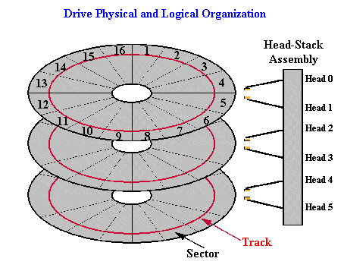
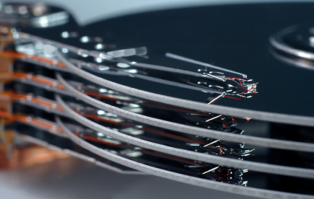
HDD OVERVIEW
Physical and logical organization
A typical HDD design consists of a spindle that holds one or more flat circular disks called platters, onto which the data are recorded. The platters are made from a non-magnetic material, usually aluminum alloy or glass, and are coated with a thin layer of magnetic material, typically 10–20 nm in thickness.

Slide 6
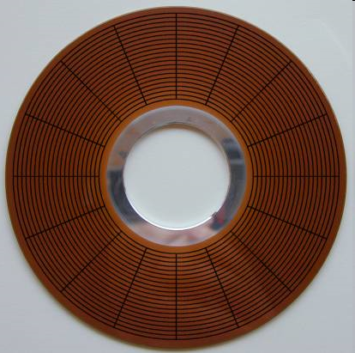
HDD OVERVIEW
Platters
The size of the platters in the hard disk is the primary determinant of its overall physical dimensions, also generally called the drive's form factor; most drives are produced in one of the various standard hard disk form factors.
Platter Diameter | Typical Form Factor | Application
5.12 | 5.25" | Oldest PCs
3.74 | 3.5" | Standard platter size for the most common hard disk drives used in PCs
3.0 | 3.5" | High-end 10,000 RPM drives
2.5 | 2.5", 3.5" | Laptop drives
1.8 | PC Card (PCMCIA) | PC Card (PCMCIA) drives for laptops
1.3 | PC Card (PCMCIA) | Originally used on hand-held PCs
1.0 | CompactFlash | Digital cameras, hand-held PCs and other consumer electronic devices

Slide 7
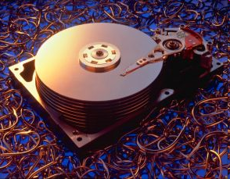
HDD OVERVIEW
Number of platters
Hard disks can have one platter, or more, depending on the design. Standard consumer hard disks, the type probably in your PC right now, usually have between one and five platters in them. Some high-end drives--usually used in servers--have as many as a dozen platters. Some very old drives had even more.
Model Number | Nominal Size (GB) | Data Sectors Per Drive | Platters | Surfaces
WD64AA | 6.4 | 12,594,960 | 1 | 2
WD102AA | 10.2 | 20,044,080 | 2 | 3
WD136AA | 13.6 | 26,564,832 | 2 | 4
WD172AA | 17.2 | 33,687,360 | 3 | 5
WD205AA | 20.5 | 40,079,088 | 3 | 6

Slide 8
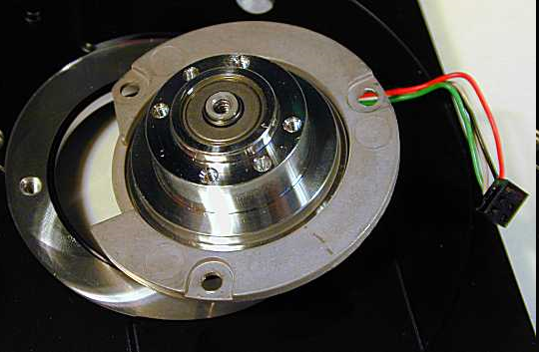
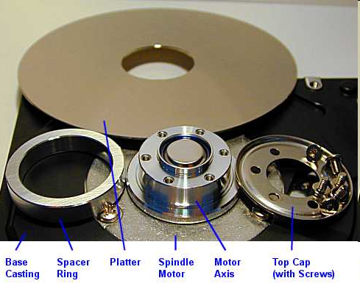
HDD OVERVIEW
Spindle
The spindle motor, also sometimes called the spindle shaft, is responsible for turning the hard disk platters, allowing the hard drive to operate.

Slide 9
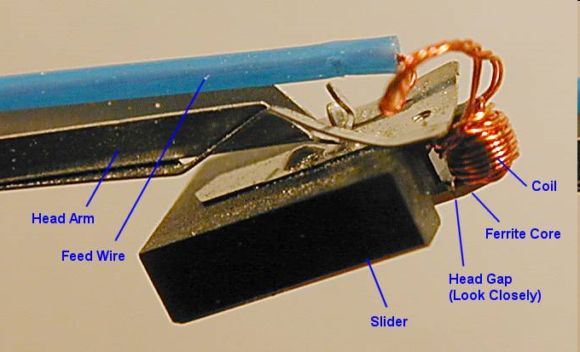
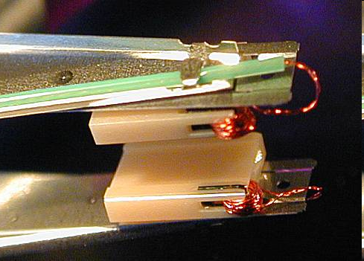
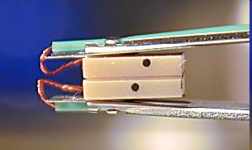
HDD OVERVIEW
R/W Head
In concept, hard disk heads are relatively simple. They are energy converters: they transform electrical signals to magnetic signals, and magnetic signals back to electrical ones again.
There is normally one head for each surface used on the drive. In the case of a drive using dedicated servo, there will be one more head than there are data surfaces. Since most hard disks have one to four platters, most hard disks have between two and eight heads. Some larger drives can have 20 heads or more.
Only one head can read from or write to the hard disk at a given time. Special circuitry is used to control which head is active at any given time.
Types of R/W head including: ferrit head, thin film head, metal-in-gap (MIG) head,…

Slide 10
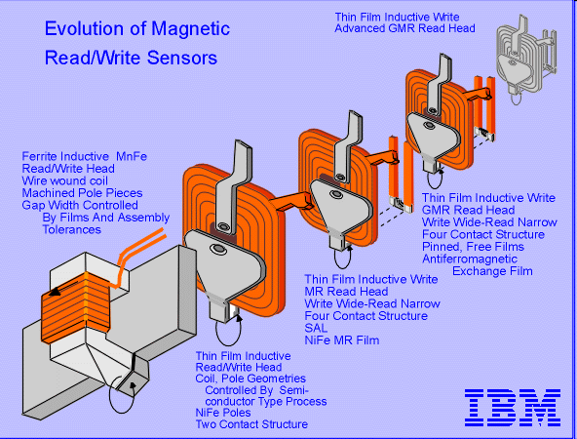
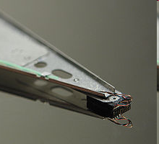
HDD OVERVIEW
R/W Head Technology
There are several different technology families that have been employed to make hard disk read/write heads. Usually, to enable hard disk speed and capacity to progress to higher levels, adjustments must be made to the way the critical read/write head operation works.

